Slide 1






MUSIC PERFORMANCE &
STREAMING ANALYTICS
DATA CLEANING, ANALYSIS &
BUSINESS INSIGHTS
Presented by
Team ANB 19
Team 2

Slide 2



PROJECT OVERVIEW
Our objective was to analyse music streaming data from multiple platforms to uncover trends, measure performance, and provide actionable business insights.
Identify top performing tracks and artists.
Understand audience engagement.
Compare performance across platforms.
Discover trends over time.
Generate insights for business decision
Presented by
Team ANB 19
Team 2

Slide 3


DATASET OVERVIEW
Total Records | 4,600
Total Columns | 27
Platforms Covered | Spotify, YouTube, TikTok, Apple Music, Deezer, Amazon, Airplay Spin, SiriusXM Spin, Pandora, Soundcloud and Shazam
Data Type | Categorical + Numerical
Time Span | Multiple Release Years
Presented by
Team ANB 19
Team 2

Slide 4






DATASET CHALLENGES
Missing Values
Duplicate Entries
Inconsistent Formats
18,194
2 Records
Casing issues and mixed
numeric syntax styles
Mixed Date Formats
Mixed Languages in Text
Null Values & Outliers
Varying date strings
(YYYY-MM-DD vs DD/MM/YYYY)
Categorical columns featuring untranslated multilingual data
Incomplete records skewing
general statistical metrics
Presented by
Team ANB 19
Team 2

Slide 5






DATA CLEANING PROCESS
Raw Data Collection
Gathered unprocessed information
Handling Missing Values
Identified and treated missing data
Formatting & Standardization
Standardized text, numbers & categories
Date Format Standardization
Converted all dates to a consistent format
Language & Text Cleaning
Translated & entered 120 datas manually in mixed language text
Consistency Check
Validated data for consistency & accuracy
Clean Dataset
High quality data ready for analysis
Presented by
Team ANB 19
Team 2

Slide 6





TOOLS & METHODOLOGY
EXCEL
Data Cleaning
Formatting
Validation
POWER QUERY
Data Transformation
Merging Queries
Data Shaping
POWER BI
DAX
Dashboard Creation
Insights & Visualization
Presented by
Team ANB 19
Team 2

Slide 7

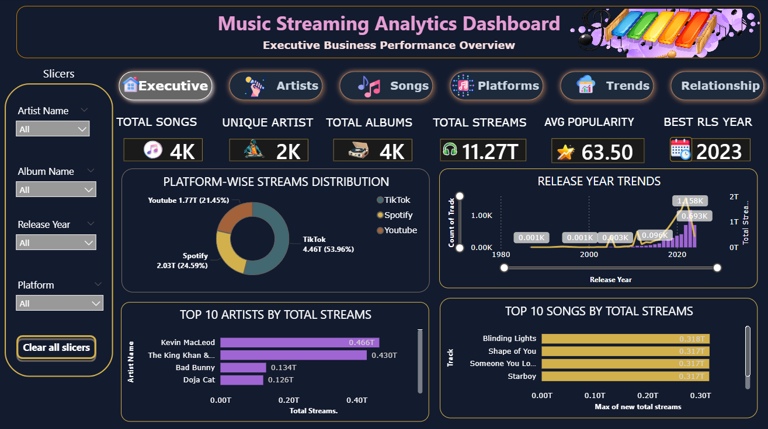
DASHBOARD OVERVIEW
Presented by
Team ANB 19
Team 2

Slide 8
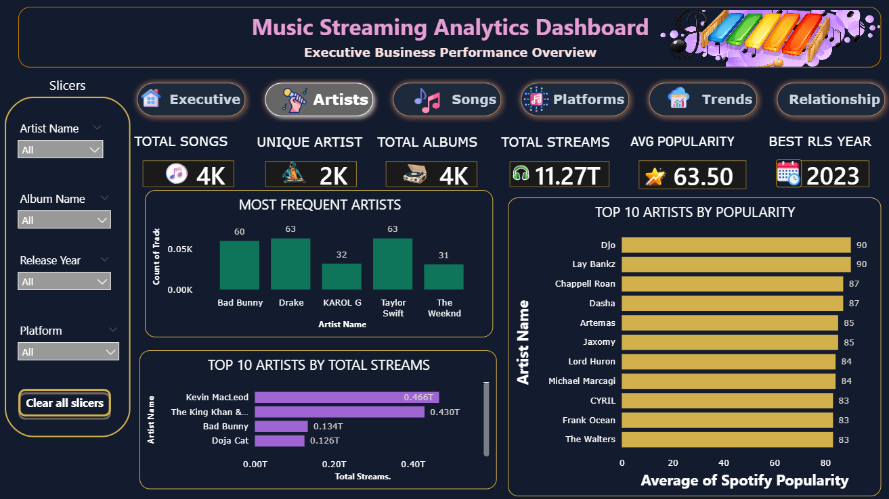
COMPARISON WITH ARTIST
Presented by
Team ANB 19
Team 2

Slide 9
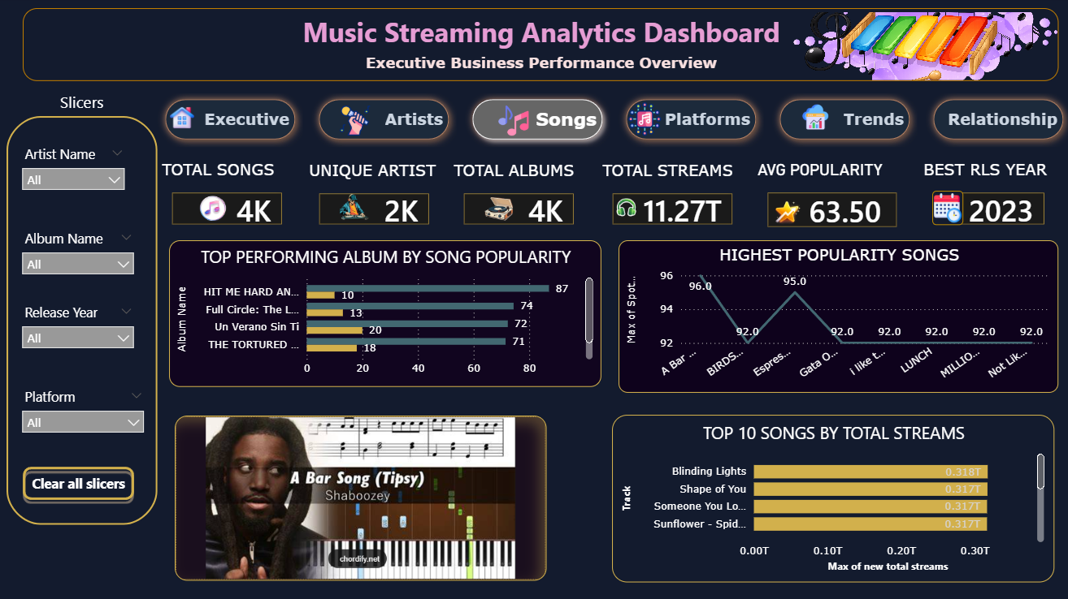
COMPARISON WITH SONGS
Presented by
Team ANB 19
Team 2

Slide 10
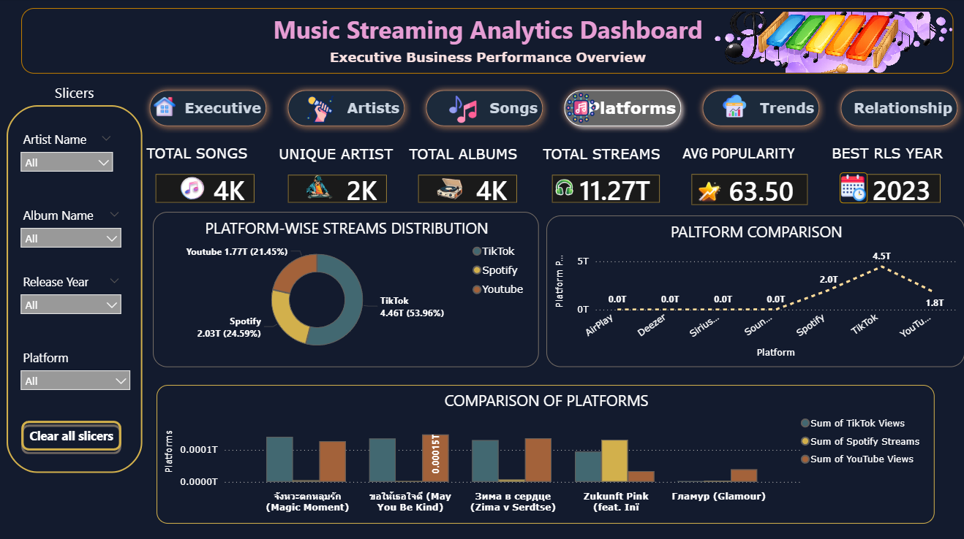
COMPARISON WITH PLATFORM
Presented by
Team ANB 19
Team 2

Slide 11
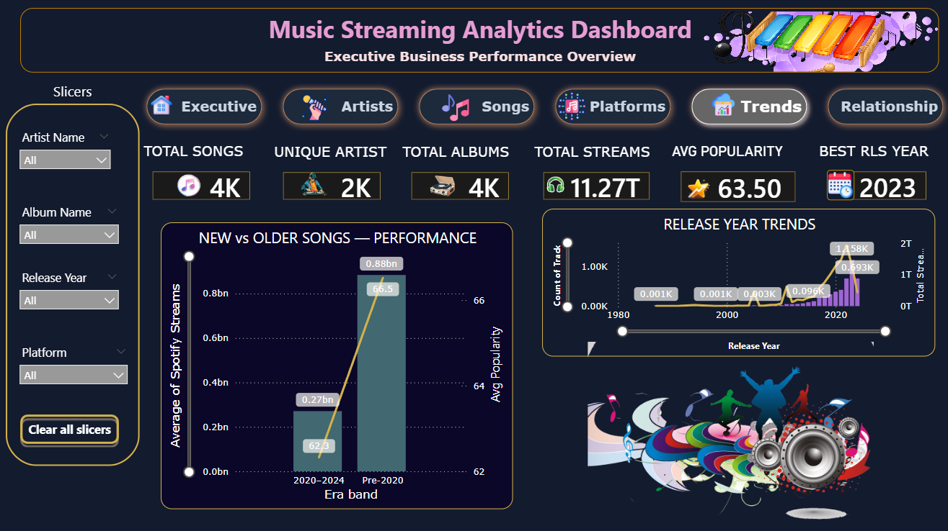
COMPARISON WITH TRENDS
Presented by
Team ANB 19
Team 2

Slide 12
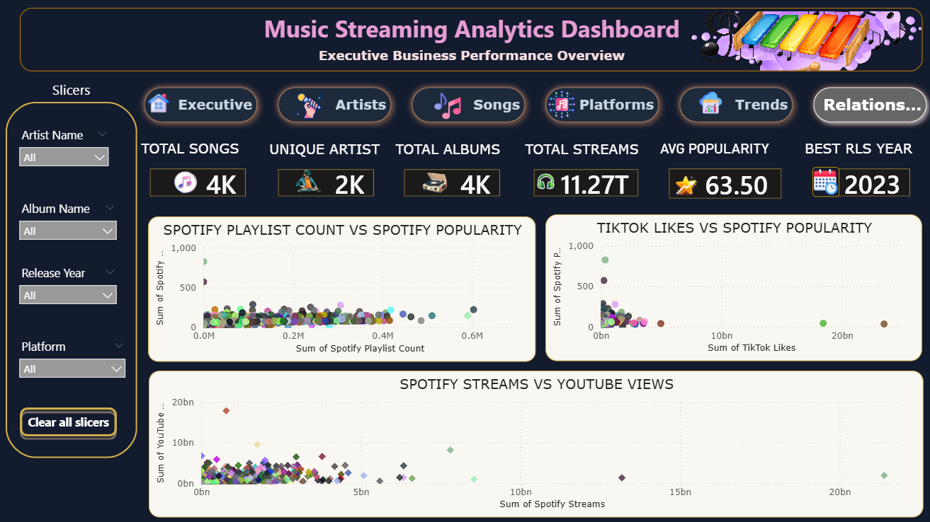
RELATIONSHIP WITH PLATFORMS
Presented by
Team ANB 19
Team 2

Slide 13

TIKTOK INSIGHTS
Total TikTok Streams
51.8 %
TikTok Playlist Reach
4.46T views
TikTok Popularity(Avg)
63.50 %
Presented by
Team ANB 19
Team 2

Slide 14
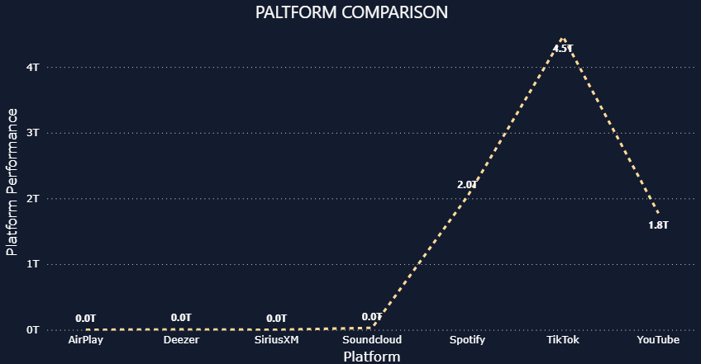
CROSS-PLATFORM COMPARISON
(TOTAL STREAMS / VIEW)
Presented by
Team ANB 19
Team 2

Slide 15
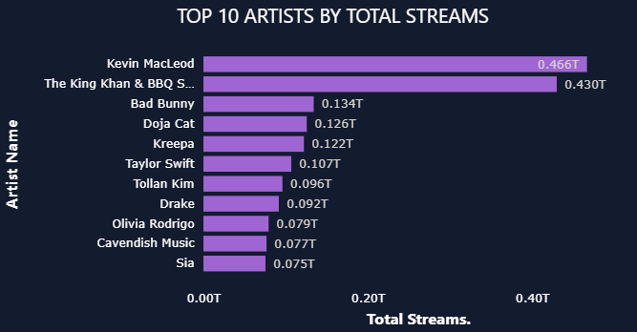
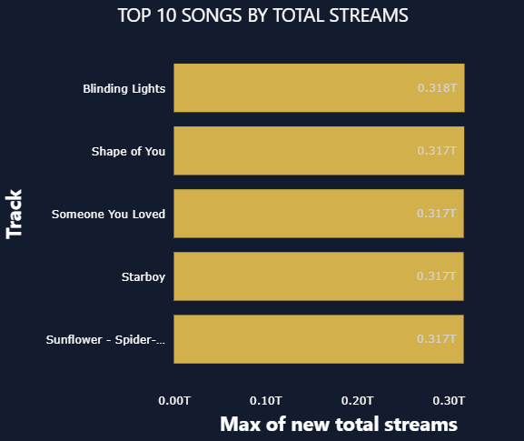
ARTIST & TRACK PERFORMANCE
Presented by
Team ANB 19
Team 2

Slide 16
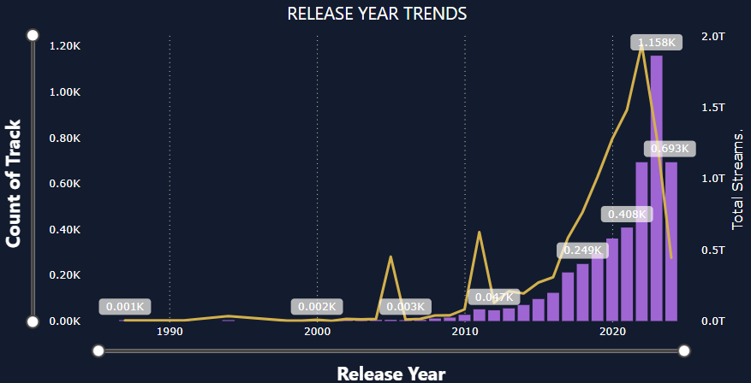
TRENDING ANALYSIS(BY RELEASE YEAR)
Presented by
Team ANB 19
Team 2

Slide 17




BUSINESS INSIGHTS
Popular Artist
Strongest Impact
First Platform & making a song a hit
“Djo” and “Lay Bankz”
Top Track
Artist Platform Focus
“A Bar Song(Tipsy)”
Focus on Spotify for maximum streaming
Most Popular Albums
YouTube Power
“HIT ME HARD AND SOFT"
Highest views and user engagement
Presented by
Team ANB 19
Team 2

Slide 18
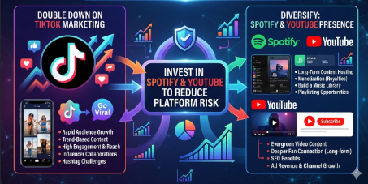
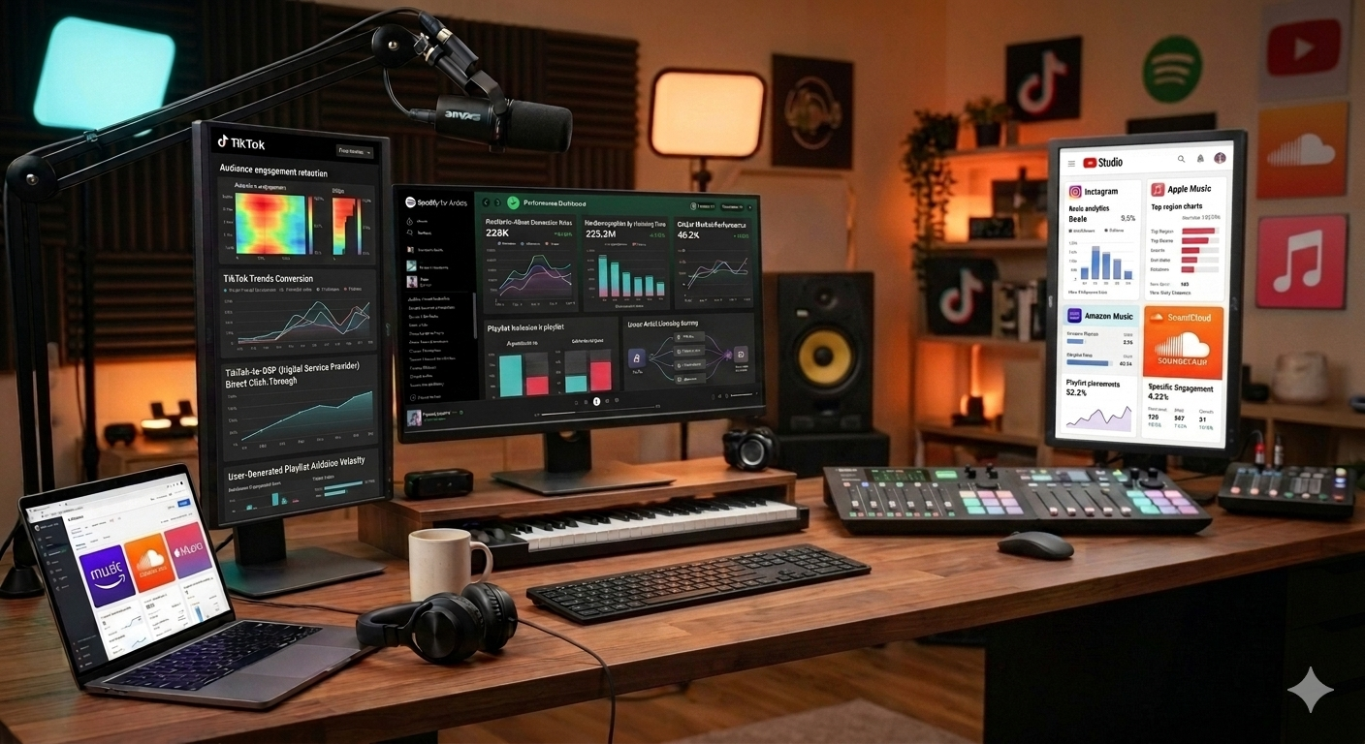
BUSINESS RECOMMENDATIONS
We should double down on TikTok
marketing while also investing
in Spotify or YouTube to reduce
platform risk.
We need to continuously monitor song performance across different platforms.
Presented by
Team ANB 19
Team 2

Slide 19


Our next marketing focus should be to
leverage the trend around Shaboozey’s "A Bar Song“(Tipsy) and collaborate with creators like Kevin MacLeod
Release music strategically based on data-driven audience behaviour
Presented by
Team ANB 19
Team 2

Slide 20

THANK YOU
Presented by
Team ANB 19
Team 2

